Slide 1







Word Embeddings to Enhance Twitter Gang Member Profile Identification
Presented at IJCAI Workshop on Semantic Machine Learning (SML 2016) New York City, NY, USA, July 10, 2016
Sanjaya Wijeratne
sanjaya@knoesis.org
Lakshika Balasuriya
lakshika@knoesis.org
Derek Doran
derek@knoesis.org
Amit Sheth
amit@knoesis.org
Ohio Center of Excellence in Knowledge-enabled Computing (Kno.e.sis)
Wright State University, Dayton, OH, USA

Slide 2

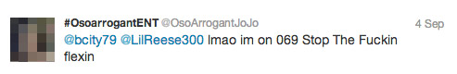
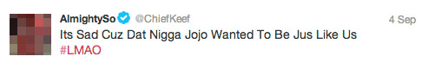
Tweets Source – http://www.wired.com/2013/09/gangs-of-social-media/all/ Image Source – http://www.7bucktees.com/shop/chi-raq-chiraq-version-2-t-shirt/ *Example tweets shown above are public data reported in the cited news paper article. They are not part of our research dataset.
Notes:
Tweets Source - http://www.wired.com/2013/09/gangs-of-social-media/all/
Image Source - http://www.7bucktees.com/shop/chi-raq-chiraq-version-2-t-shirt/
*Example tweets shown above are public data reported in the cited news paper article. They are not part of our research dataset

Slide 3

What does gang related research tell us?
“Gangs use social media mainly to post videos depicting their illegal behaviors, watch videos, threaten rival gangs and their members, display firearms and money from drug sales” [Patton 2015, Morselli 2013]
Studies have shown,
82% of gang members had used the Internet and 71% of them had used social media [Decker 2011]
45% of gang members have participated in online offensive activities and 8% of them have recruited new members online [Pyrooz 2013]
Image Source – http://www.sciencenutshell.com/wp-content/uploads/2014/12/o-GANG-VIOLENCE-facebook.jpg
Notes:
Image Source - http://www.sciencenutshell.com/wp-content/uploads/2014/12/o-GANG-VIOLENCE-facebook.jpg

Slide 4
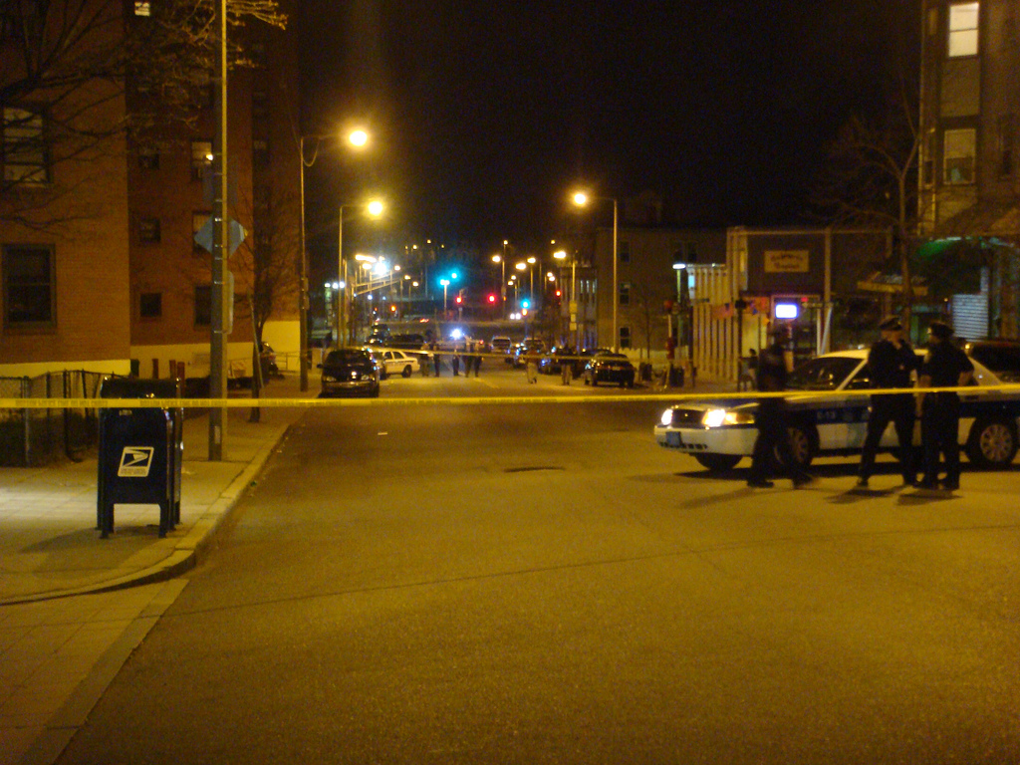
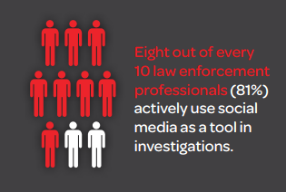
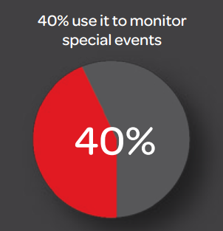
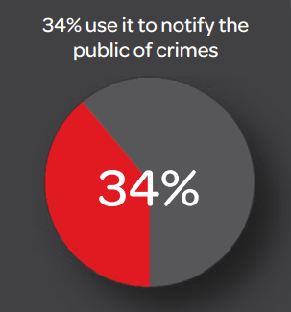
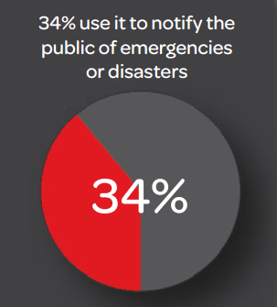
There are other spectators too…
Source – http://www.lexisnexis.com/risk/downloads/whitepaper/2014-social-media-use-in-law-enforcement.pdf
Image Source – http://www.officialpsds.com/images/stocks/crime-scene-stock1016.jpg
Notes:
Image Source - http://www.officialpsds.com/images/stocks/crime-scene-stock1016.jpg

Slide 5
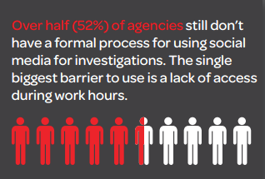
But there’s a problem…
Wijeratne, Sanjaya et al. "Analyzing the Social Media Footprint of Street Gangs" in IEEE ISI 2015, doi: 10.1109/ISI.2015.7165945 Source – http://www.lexisnexis.com/risk/downloads/whitepaper/2014-social-media-use-in-law-enforcement.pdf
Image Source – http://www.officialpsds.com/images/stocks/crime-scene-stock1016.jpg
Notes:
Image Source - http://www.officialpsds.com/images/stocks/crime-scene-stock1016.jpg

Slide 6
Enhance Twitter Gang Member Profile Identification with Word Embeddings
Balasuriya, Lakshika et al. “Finding Street Gang Members on Twitter”, Technical Report, Wright State University, 2016
Image Source – http://www.sciencenutshell.com/wp-content/uploads/2014/12/o-GANG-VIOLENCE-facebook.jpg
Notes:
Image Source - http://www.sciencenutshell.com/wp-content/uploads/2014/12/o-GANG-VIOLENCE-facebook.jpg

Slide 7
Gang Member Dataset
Description | Gang Member Class | Non-gang Member Class | Total
Number of Profiles | 400 | 2,865 | 3,265
Number of Tweets | 821,412 | 7,238,758 | 8,060,170
Number of Words from each Feature | Gang Member Class | Non-gang Member Class | Total
Tweets | 3,825,092 | 45,213,027 | 49,038,119
Profile Descriptions | 3,348 | 21,182 | 24,530
Emoji | 732,712 | 3,685,669 | 4,418,381
YouTube Videos | 554,857 | 10,459,235 | 11,041,092
Profile Images | 10,162 | 73,252 | 83,414
Total | 5,126,176 | 59,452,365 | 64,578,536
Balasuriya, Lakshika et al. “Finding Street Gang Members on Twitter”, Technical Report, Wright State University, 2016

Slide 8
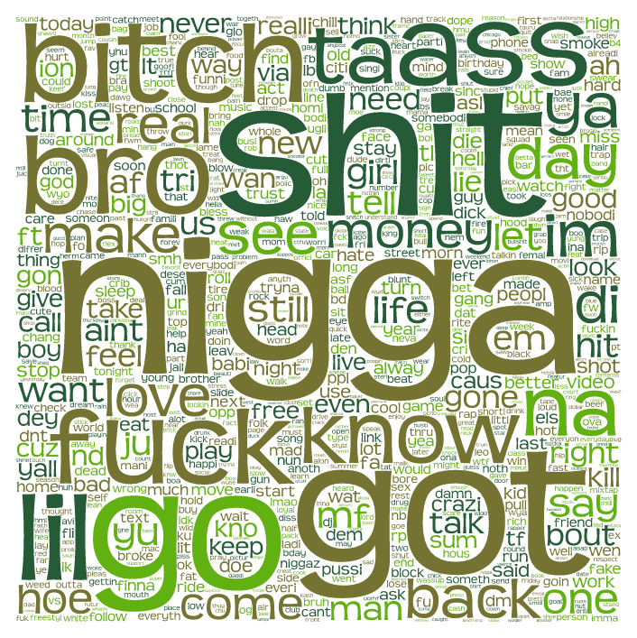

Feature Type – Tweets
Words from Gang Member’s Tweets
Words from Non-gang Member’s Tweets
Balasuriya, Lakshika et al. “Finding Street Gang Members on Twitter”, Technical Report, Wright State University, 2016

Slide 9
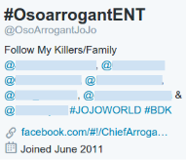
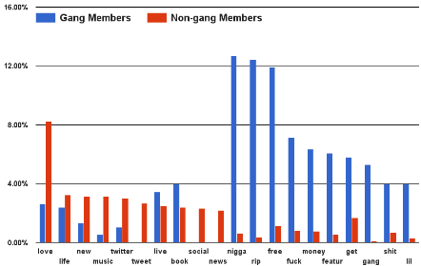
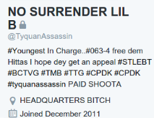
Feature Type – Profile Descriptions
Percent of profiles that contain the word in profile description
Word usage in profile descriptions: Gang Vs. Non-gang members
Balasuriya, Lakshika et al. “Finding Street Gang Members on Twitter”, Technical Report, Wright State University, 2016 *Example Twitter profiles shown above are public data reported in news articles. They are not part of our research dataset.
Notes:
*Example Twitter profiles shown above are public data reported in news articles. They are not part of our research dataset.

Slide 10
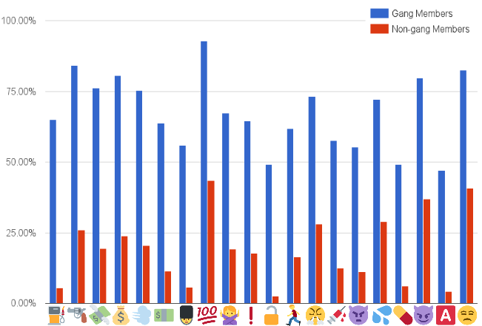
Feature Types – Emoji
Percent of profiles that contains the emoji in Tweets
Emoji usage distribution: Gang Vs. Non-gang members
Balasuriya, Lakshika et al. “Finding Street Gang Members on Twitter”, Technical Report, Wright State University, 2016

Slide 11
Feature Types – YouTube Links
51.25% of gang members post at least one YouTube video
76.58% of them are related to gangster hip-hop
A gang member shares 8 YouTube links on average
Top 5 words from gang members – shit, like, nigga, fuck, lil
Top 5 words from non-gang members – like, love, peopl, song, get
Balasuriya, Lakshika et al. “Finding Street Gang Members on Twitter”, Technical Report, Wright State University, 2016

Slide 12
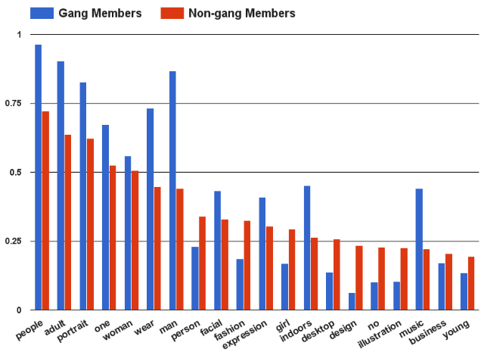
Feature Types – Profile Images
Percent of profiles that contains the image tag
Image tags distribution: Gang Vs. Non-gang members
Balasuriya, Lakshika et al. “Finding Street Gang Members on Twitter”, Technical Report, Wright State University, 2016

Slide 13
Classification Approach
Convert all non textual features to text
Emoji for Python API for emoji¹
Clarifai API for profile and cover images²
Remove stop word and stem the remaining
Train a Skip-gram model using textual features
Negative sample rate = 10
Context window size = 5
Ignore words with min count = 5
Number of dimensions = 300
¹https://pypi.python.org/pypi/emoji | ²http://www.clarifai.com/

Slide 14
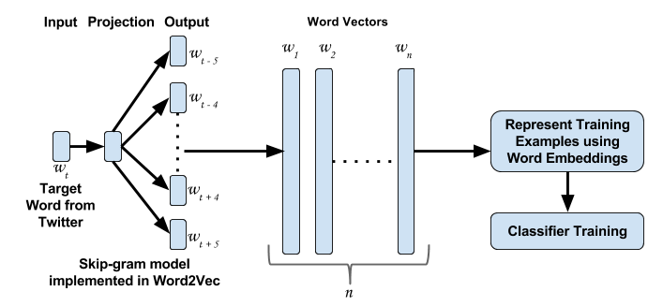
Classification Approach Cont.
Classifier training with word embeddings

Slide 15
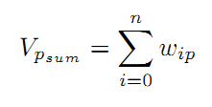
Representing Training Examples
For each Twitter profile p, with n unique words, and the vector of the i^{th} word in p denoted by w_{ip}, we compute the feature vectors for V_{p} in the following ways.
Sum of word embeddings – Sum of word vectors for all words in Twitter profile p

Slide 16
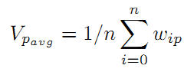
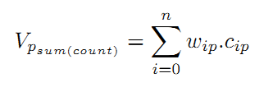
Representing Training Examples Cont.
Mean of word embeddings – Mean of word vectors for all words in Twitter profile p
Sum of word embeddings weighted by term frequency where term frequency of i^{th} word in p is denoted by c_{ip}

Slide 17
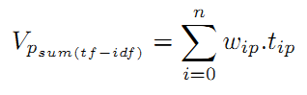
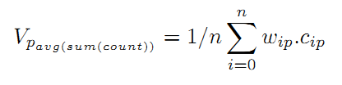
Representing Training Examples Cont.
Sum of word embeddings weighted by tf-idf where tf-idf of i^{th} word in p is denoted by t_{ip}
Sum of word embeddings weighted by term frequency where term frequency of i^{th} word in p is denoted by c_{ip}.

Slide 18
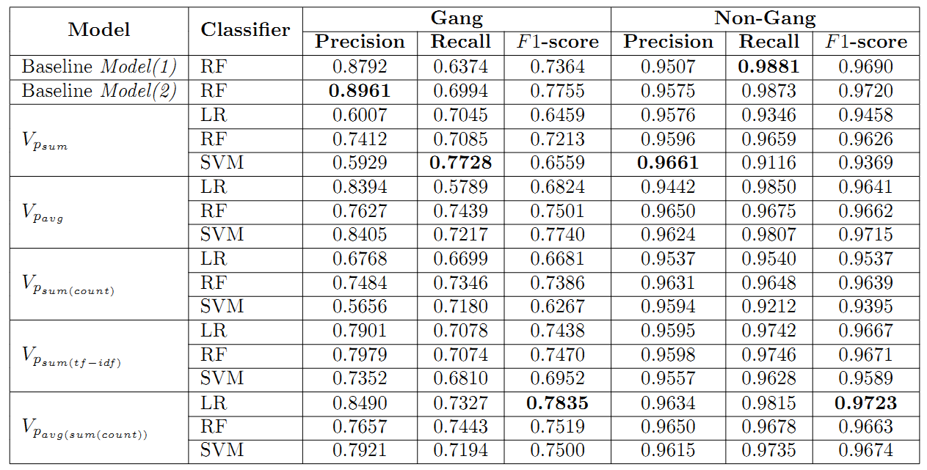
Classification Results
Classification results based on 10-fold cross validation

Slide 19
Results Interpretation
Averaging the vector sum weighted by term frequency performs the best
Out of the five vector based operations on word embeddings;
Four of them gave classifiers that beat baseline model(1)
Two of them performed as nearly equal or beat baseline model(2)

Slide 20
Results Interpretation Cont.
Word vector (top 10) for BDK showed
Five were rival gangs of Black Disciples
Two were syntactic variations of BDK
Three were syntactic variations of GDK
Word vector (top 10) for GDK showed
Six were Gangster Disciple gangs where others have expressed their hatred towards them
Word vector (top 10) for CPDK showed
Other keywords showing hatred towards cops such as fuck12, fuckthelaw, fuk12 and gang names

Slide 21

Challenges and Future work
Build image recognition systems that can accurately identify images commonly posted by gang members
Guns, Drugs, Money, Gang Signs
Integrate slang dictionaries and use them to pre-train word embeddings
Hipwiki.com
Utilize social networks of gang members to identify new gang members
Image Source – http://i.ytimg.com/vi/dqyYvIqjuFI/maxresdefault.jpg
Notes:
Image Source - http://i.ytimg.com/vi/dqyYvIqjuFI/maxresdefault.jpg

Slide 22




Connect with me
sanjaya@knoesis.org
@sanjrockz
http://bit.do/sanjaya
Image Source – http://www.pcb.its.dot.gov/standardstraining/mod08/ppt/m08ppt23.jpg
Notes:
Image Source - http://www.pcb.its.dot.gov/standardstraining/mod08/ppt/m08ppt23.jpg

Slide 23



Slide 24
References
[1] D. U. Patton, “Gang violence, crime, and substance use on twitter: A snapshot of gang communications in Detroit,” Society for Social Work and Research 19th Annual Conference: The Social and Behavioral Importance of Increased Longevity, Jan 2015
[2] C. Morselli and D. Decary-Hetu, “Crime facilitation purposes of social networking sites: A review and analysis of the cyber banging phenomenon,” Small Wars & Insurgencies, vol. 24, no. 1, pp. 152–170, 2013
[3] S. Decker and D. Pyrooz, “Leaving the gang: Logging off and moving on. Council on foreign relations,” 2011

Slide 25
References Cont.
[4] D. C. Pyrooz, S. H. Decker, and R. K. Moule Jr, “Criminal and routine activities in online settings: Gangs, offenders, and the internet,” Justice Quarterly, no. ahead-of-print, pp. 1–29, 2013
[5] S. Wijeratne, D. Doran, A. Sheth, and J. L. Dustin, “Analyzing the social media footprint of street gangs”, In Proc. of IEEE ISI, 2015, pages 91–96, May 2015.
[6] L. Balasuriya, S. Wijeratne, D. Doran, and A. Sheth, “Finding street gang members on twitter”, In Technical Report, Wright State University, 2016.

